Slide 1
Target HTTPS Proxy
URL Rewriting: Proxies can rewrite URLs to make them more user-friendly or to route traffic to specific backend services.
Mapping Custom Domains to Cloud Run
https://cloud.google.com/run/docs/mapping-custom-domains?_gl=1*1jfmszt*_ga*MjA5MzY2MTIxMy4xNzA1NTQ2Mzk4*_ga_WH2QY8WWF5*MTcwNTU0NjgzMS4xLjEuMTcwNTU0NjgzMi4wLjAuMA..&_ga=2.155876152.-2093661213.1705546398#run

Slide 2
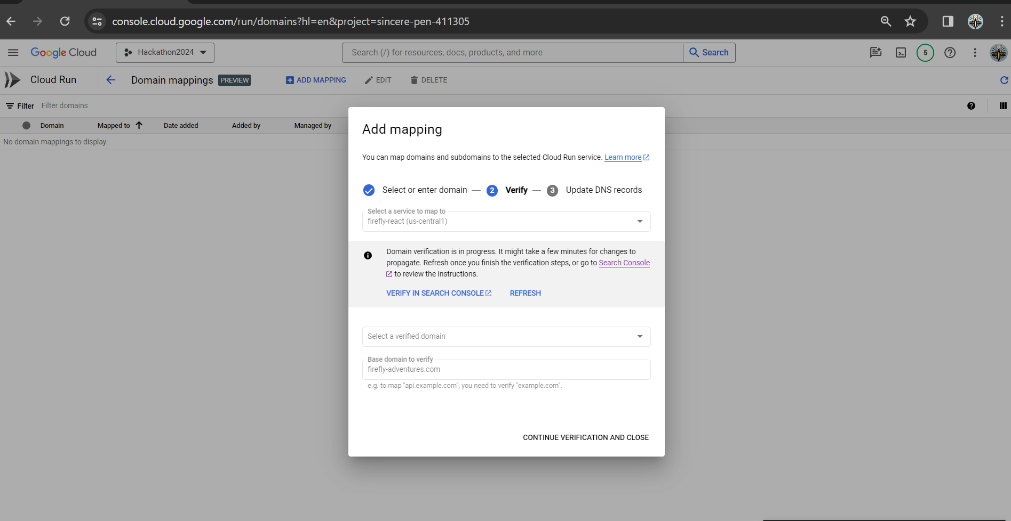
Cloud Run – Domain Mapping

Slide 3
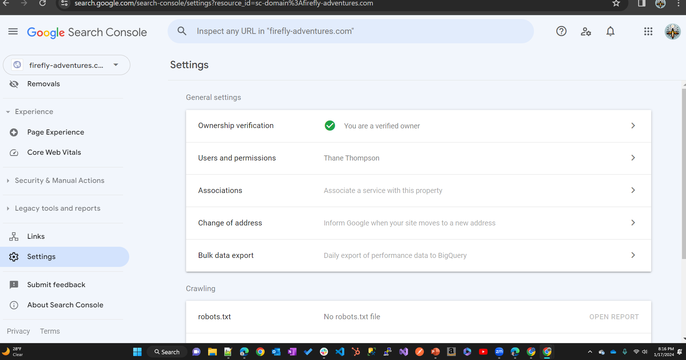
Google Search Console – Verification of Domain Name Ownership
Google Search Console is a web service by Google which allows webmasters to check indexing status, search queries, crawling errors and optimize visibility of their websites.

Slide 4
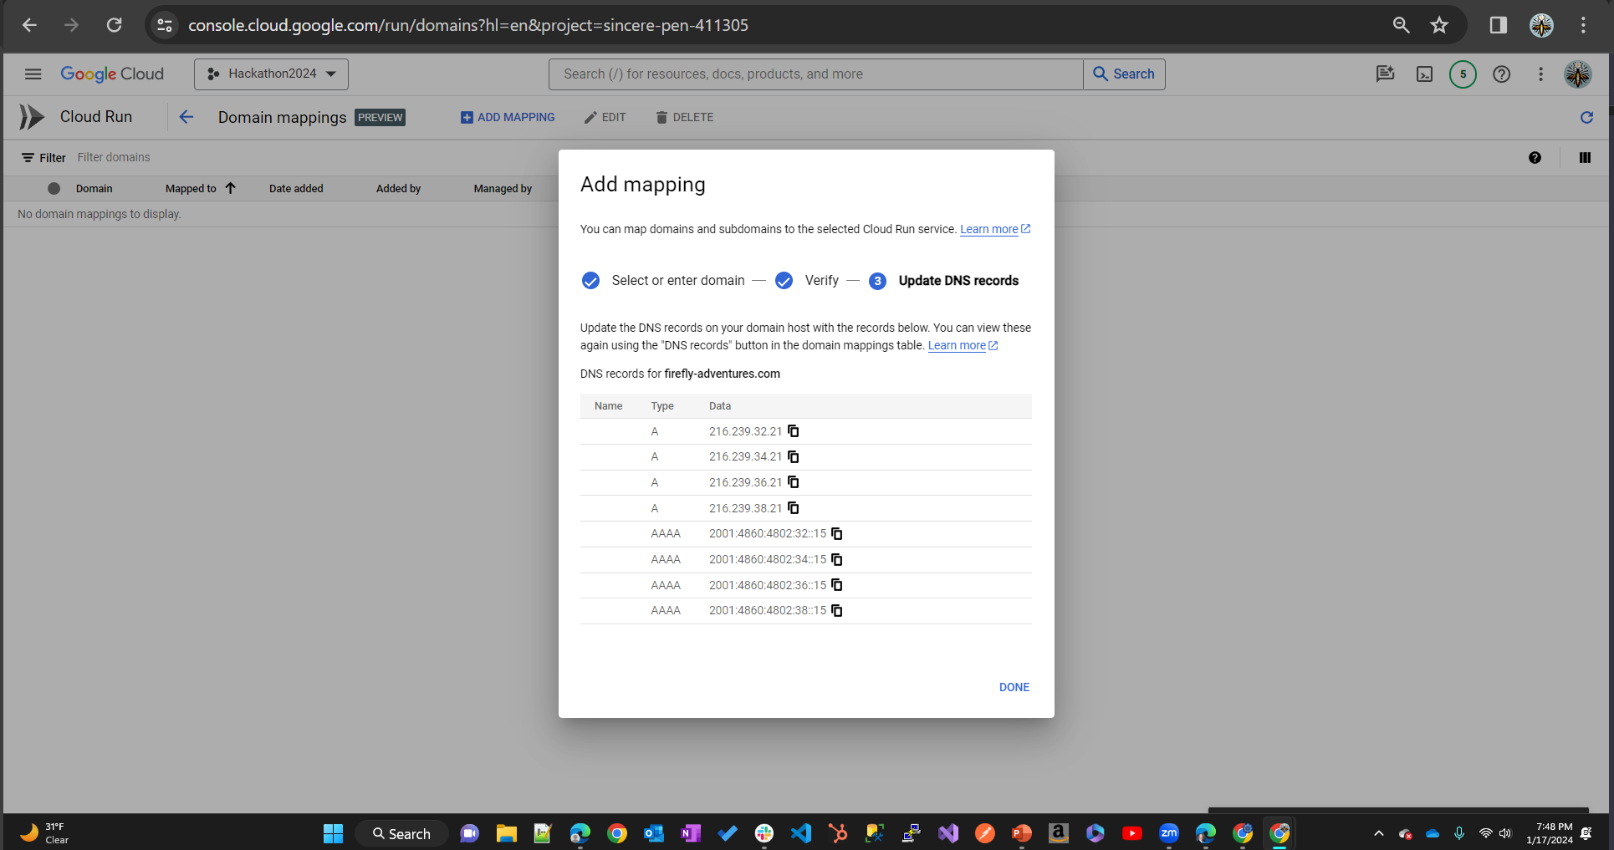
Cloud Run – Verification of Domain Name Ownership

Slide 5
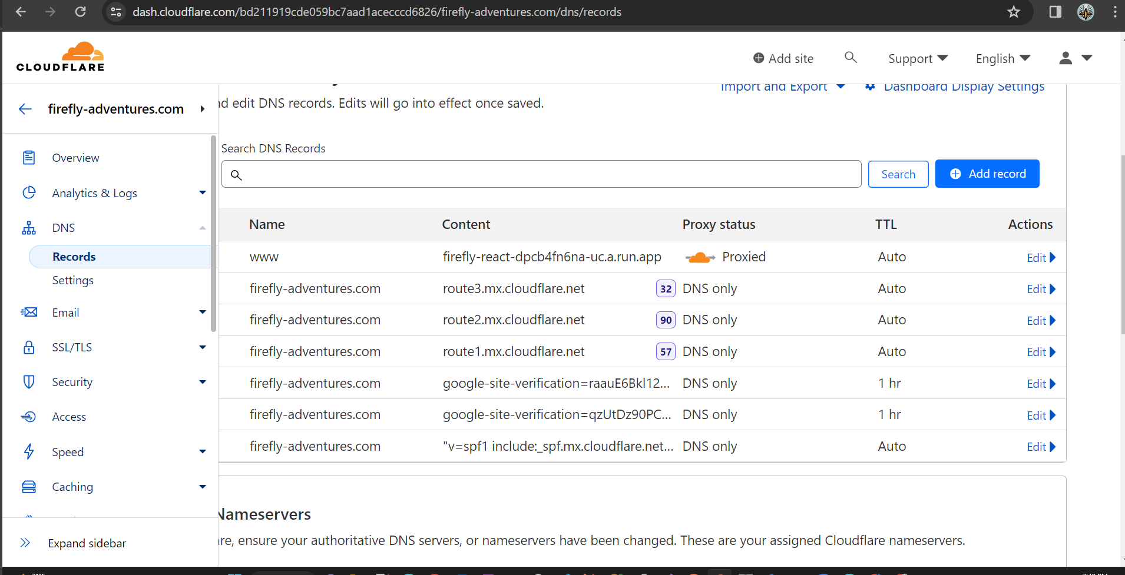
Cloudflare– Change DNS Records

Slide 6
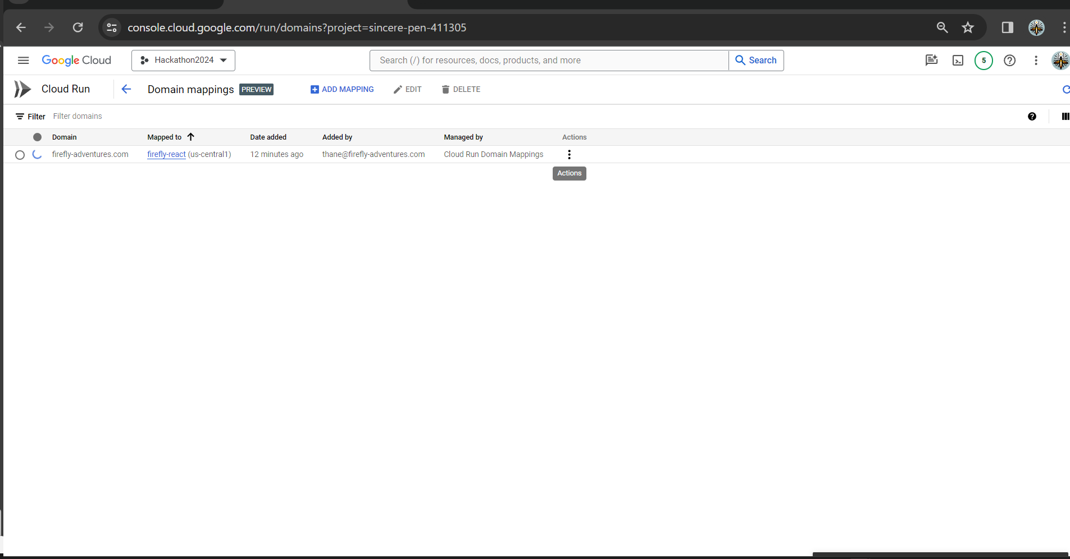
Cloud Run– Domain Mappings – Pending Verification
Spinning Circle pending verification via Google Search Console (for domains and IP addresses)

Slide 7
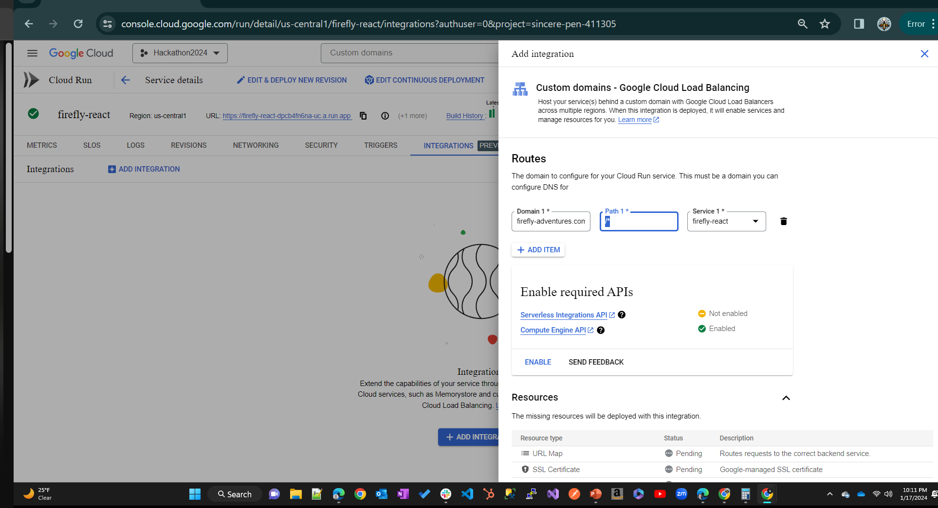
Cloud Run– Integrations – Custom Domain Mapping w/Load Balancer

